Slide 1
Sprint 3
Level shifts

Slide 2
Levelshifts

Slide 3
Timestamps

Slide 4
Importance
Visualization:
Its either TIMESTAMP or SEQUENCE
INBO:
Can make sure that timestamp is always available.
Other parties?

Slide 5
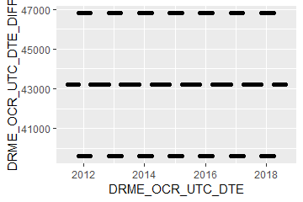
Timestamps: varying time-difference between observations (BAOL068X_180816.csv)
Sometimes 11, 12 or 13 hours
Notes:
BAOL068X_180816.csv

Slide 6
Timestamps: varying time-difference between observations
Equidistant observations are important for ARIMA-like timeseries models.
Without equidistance, the usability of ARIMA is limited.
Example: Differencing
For small time-differences: measured differences determined by sensor inaccuracy
For large time-differences: measured differences determined by sensor inaccuracy and atmospheric changes.
Timestamps: Take into account all kinds of scenarios?

Slide 7
strucchange package

Slide 8
Strucchange package
Pros:
Mature package
Relatively fast: 5 min average
Cons:
Uses lots of memory (+5GB on some cases)

Slide 9
tsoutliers package
Level Shifts

Slide 10
tsoutliers package
Pros:
Mature package
Relatively fast: 5 min average
Cons:
Uses lots of memory (+5GB on some cases)

Slide 11
gwloggeR
Feedback?

Slide 12
Change log
“Diver” → “hydrostatic pressure”
ap <- apriori("hydrostatic pressure", "cmH2O")
detect_outliers(x, apriori = ap)
detect_duplicates(ts)

Slide 13
Next steps

Slide 14
Next steps
Outliers v0.02
Build kernel based on clean data
Document in detail
Notes:
temporal change : multiple points after the change should be “red”
Level shifts: how to flag those?

Slide 15
Hysteresis?

Slide 16
The End

Slide 17
Sprint 2
Outliers

Slide 18
Agenda
DRME_DMST_CDE validation
Outliers: v0.02 update
Comparison v0.01 vs v0.02
gwloggeR v0.1.1
Assessment
anomalize
tsoutliers

Slide 19
DRME_DMST_CDE
Flags from DB: ENT (entered); DEL (deleted) and INV (invalid).

Slide 20
DRME_DMST_CDE
On all *.csv-data:
DEL ENT INV VLD <NA>
462 556271 4697 16 0

Slide 21
DRME_DMST_CDE: VLD and DEL
PPNT_ID PPNT_CDE DRSO_ID DRSO_SER_NBR DRME_ID DRME_OCR_UTC_DTE DRME_DRU DRME_TPU DRME_DMTP_CDE DRME_DMST_CDE SEQUENCE
1: 7019 BAOL001X 275 D0939 238389 2010-11-11 10:00:00 1018.100 NA LDME VLD 1093
2: 7019 BAOL001X 275 D0939 1824560 2010-11-11 10:00:00 1018.075 6.033 LDME ENT 1130
3: 7019 BAOL001X 275 D0939 238390 2010-11-11 22:00:00 1007.300 NA LDME VLD 1094
4: 7019 BAOL001X 275 D0939 1824561 2010-11-11 22:00:00 1007.275 8.163 LDME ENT 1131
5: 7019 BAOL001X 275 D0939 238391 2010-11-12 10:00:00 1015.400 NA LDME VLD 1095
6: 7019 BAOL001X 275 D0939 1824562 2010-11-12 10:00:00 1015.375 11.213 LDME ENT 1132
7: 7019 BAOL001X 275 D0939 238392 2010-11-12 22:00:00 1012.900 NA LDME VLD 1096
8: 7019 BAOL001X 275 D0939 1824563 2010-11-12 22:00:00 1012.850 12.457 LDME ENT 1133
9: 7019 BAOL001X 275 D0939 238393 2010-11-13 10:00:00 1014.600 NA LDME VLD 1097
10: 7019 BAOL001X 275 D0939 1824564 2010-11-13 10:00:00 1014.600 10.810 LDME ENT 1134
11: 7019 BAOL001X 275 D0939 238394 2010-11-13 22:00:00 1012.700 NA LDME VLD 1098
12: 7019 BAOL001X 275 D0939 1824565 2010-11-13 22:00:00 1012.675 10.953 LDME ENT 1135
Duplicates: Detect those too?
Notes:
Duplicaten in de DB?

Slide 22
DRME_DMST_CDE: INV
Validation

Slide 23
DRME_DMST_CDE: INV
Validation

Slide 24

DRME_DMST_CDE: INV
Validation
No Timestamp (Inconsistent)
No Timestamp: Detect those too?
Notes:
Inconsistent because there are also black dots that have no timestamp.

Slide 25
Outliers: v0.02 update
Uses simple a-priori knowledge about air pressure, temperature, etc.

Slide 26


Outliers: v0.02 update
Validation
Excluded: BAOL089|BAOL079|BAOL006 (mBar)
Range: 800 < x < 1200
Notes:
Excluded: BAOL089|BAOL079|BAOL006
Range: 800 < x < 1200

Slide 27
Outlier comparison
v0.01, v0.02, DRME_DMST_CDE

Slide 28
Outlier comparison

Slide 29
Outlier comparison

Slide 30
Outlier comparison

Slide 31
Outlier comparison

Slide 32
Outlier comparison

Slide 33
Outlier comparison

Slide 34
Outlier comparison

Slide 35
Outlier comparison

Slide 36
tsoutliers package

Slide 37

tsoutliers package
auto.arima(Nile)
Series: Nile
ARIMA(1,1,1)
Coefficients:
ar1 ma1
0.2544 -0.8741
s.e. 0.1194 0.0605
sigma^2 estimated as 19769: log likelihood=-630.63
AIC=1267.25 AICc=1267.51 BIC=1275.04
nile.outliers <- tso(Nile,types = c("AO","LS","TC"))
nile.outliers
Series: Nile
ARIMA(0,0,0) with non-zero mean
Coefficients:
intercept LS29 AO43
1097.7500 -242.2289 -399.5211
s.e. 22.6783 26.7793 120.8446
sigma^2 estimated as 14401: log likelihood=-620.65
AIC=1249.29 AICc=1249.71 BIC=1259.71
Outliers:
type ind time coefhat tstat
1 LS 29 1899 -242.2 -9.045
2 AO 43 1913 -399.5 -3.306
Notes:
https://stats.stackexchange.com/questions/104882/detecting-outliers-in-time-series-ls-ao-tc-using-tsoutliers-package-in-r-how

Slide 38
tsoutliers package: AO’s

Slide 39
tsoutliers package: AO’s

Slide 40
tsoutliers package: AO’s
WRONG
TIMESTAMPS NOT SEQUENTIAL
Notes:
Afstandedn veel groter sinds 2018

Slide 41

tsoutliers package
Pros:
Formalism
Integration with (S)ARIMA
Cons:
Speed? (+12h on BAOL033X_C6550.csv)
Ad-hoc (messy) solution
ToDo:
Simulations for validation
Visualization of AO, LS en TC outliers
Think it best works with “all” outliers enabled.
Notes:
Zou best

Slide 42
anomalize package

Slide 43

anomalize package
vs. tsoutliers
Notes:
Same Nile dataset

Slide 44
anomalize package
Pros:
Straightforward and fast timeseries decomposition
Cons:
Only AO
LS and TC can not be specified
Not backed by decent theory
Notes:
Zou best

Slide 45
gwloggeR
Feedback?

Slide 46
Next steps

Slide 47
Next steps
Define control vocabulary?
Suggested function output:
?
Notes:
temporal change : multiple points after the change should be “red”
Level shifts: how to flag those?

Slide 48
Next steps
Go further with tsoutliers
Visualisation: level shift (LS)
Simulations
Give a better idea of model performance for specific cases
Examples:
ARIMA(0,0,0) with AO
ARIMA(0,0,0) with LS
etc.
gwloggeR versioning?
Notes:
temporal change : multiple points after the change should be “red”
Level shifts: how to flag those?

Slide 49
The End

Slide 50
Sprint 1
Outliers

Slide 51
Outliers
v0.01: detect_outliers(data)
Uses only the supplied dataset
v0.02: detect_outliers(data, type = c(“air pressure”, “air temperature”), units)
Uses simple a-priori knowledge about air pressure, temperature, etc.
v0.03: …

Slide 52
Outliers: v0.01
Uses only the supplied dataset

Slide 53
Outliers: v0.01
Validation

Slide 54
Outliers: v0.01
Validation

Slide 55
Outliers: v0.01
Validation

Slide 56
Outliers: v0.01
Validation

Slide 57
Outliers: v0.01
Validation

Slide 58
Outliers: v0.01
Validation

Slide 59
Outliers: v0.01
Validation

Slide 60
Outliers: v0.01
Validation
Scale completely wrong?

Slide 61
Outliers: v0.02
Uses simple a-priori knowledge about air pressure, temperature, etc.

Slide 62


Outliers: v0.02
Validation

Slide 63
Outliers: v0.02
Validation

Slide 64
Outliers: v0.02
Validation

Slide 65
Outliers: v0.02
Validation

Slide 66
Summary
Outliers: v0.01
detect_outliers(data)
Usable on any data (not only L - lucht)
Scale can be completely wrong (cf. BAOL018X_42112)
Outliers: v0.02:
detect_outliers(data, type = c(“air pressure”, “air temperature”), units)
Needs a-priori information
Type
Units
Fixed or dynamic thresholds?
Notes:
Tresholds voor outliers kunnen berekend worden op basis van handmatige prior analyse, of

Slide 67
Outliers: v0.03
Go even further with a-priori information?

Slide 68

Outliers: v0.03
Even more a-priori information to explain variation
Notes:
Bijvoorbeeld, somige regio’s hebben lagere of hogere temperature, wat resulteert in hogere of lagere luchtdruk.

Slide 69
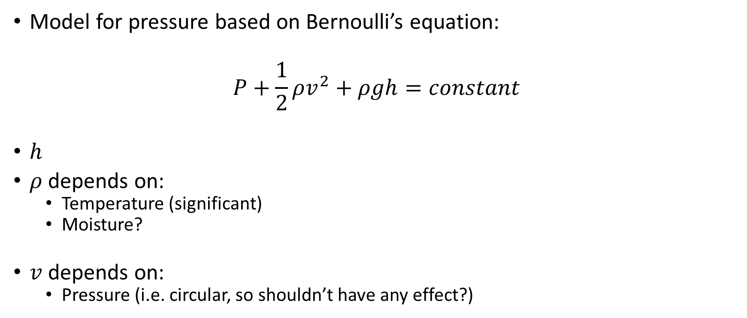
Outliers: v0.03
Model for pressure based on Bernoulli’s equation:
$$P+\frac{1}{2}ρv^{2}+ρgh=constant$$
$h$
$ρ$ depends on:
Temperature (significant)
Moisture?
$v$ depends on:
Pressure (i.e. circular, so shouldn’t have any effect?)

Slide 70

Outliers: v???
First order difference: very long tails
Notes:
Very long tails, not normal

Slide 71
Next steps

Slide 72
Next steps
Make first version of package with outlier detector 0.01 and 0.02?
If no extra data supplied, use v0.01, else v0.02?
v0.02: fixed or dynamic thresholds?
Other ideas?
Notes:
Misschien best om zo snel mogelijk met package te beginnen: dan kan gebruik meteen geevalueerd worden.

Slide 73
The End

